Slide 1
Week 8
MongoDB Aggregation Framework

Slide 2
Lesson 15
Aggregation Framework

Slide 3
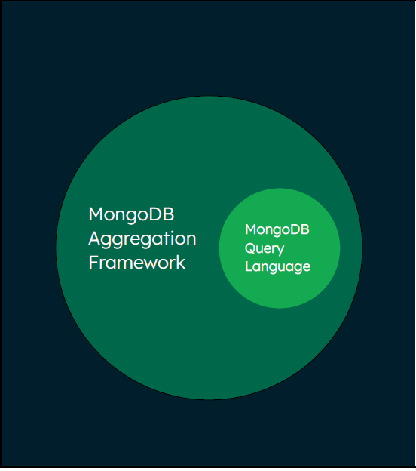
Aggregation Framework
Extends what can be done with data in MongoDB
Applies a sequence of query operations that can reduce and transform the documents.
MQL is specifically designed to query, it is not designed to manipulate data or return computed results.
It has a much wider set of functionality than available in MQL.

Slide 4
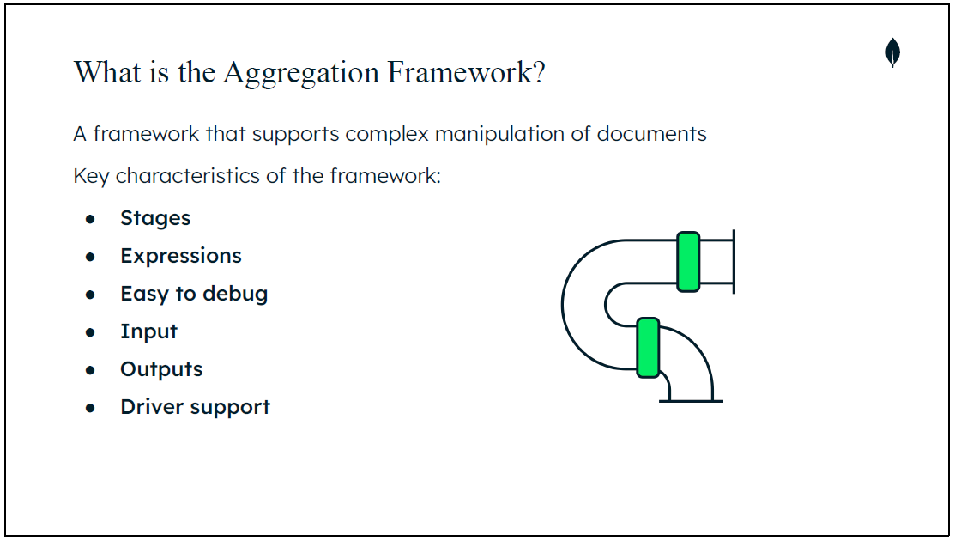
Notes:
Stages: It is broken into stages, these sequentially perform an operation or set of operations within a pipeline of stages.
Expressions: Cover a large toolkit of operators, functions and algorithms that can be used within the stages.
Easy to debug: The complex pipelines of many stages are easier to debug as the problem can typically be localised to a single stage rather than needing to debug the entire pipeline. This is unlike aggregations in relational databases.
In terms of input to the aggregation pipeline, a single collection is used however the documents in this collection are copied and are not modified. The pipeline holds a copy of the documents and any modifications made to them as they move through the various stages of the pipeline.
Outputs: Outputs from an aggregation pipeline can be saved to a collection or they can be made available to an application as a cursor (using a MongoDB Driver).
Driver support: All of the MongoDB Drivers support the Aggregation Framework.

Slide 5
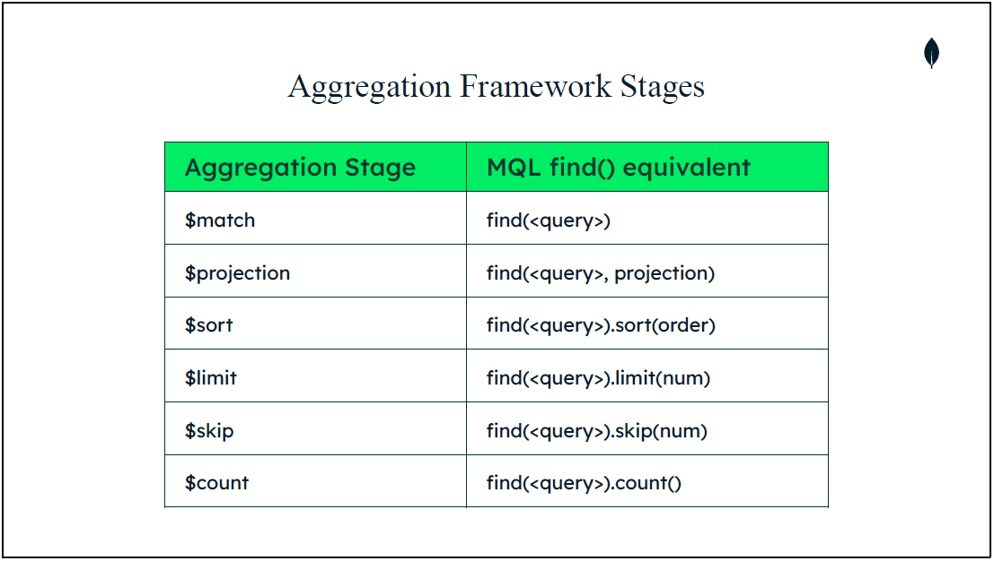

Slide 6
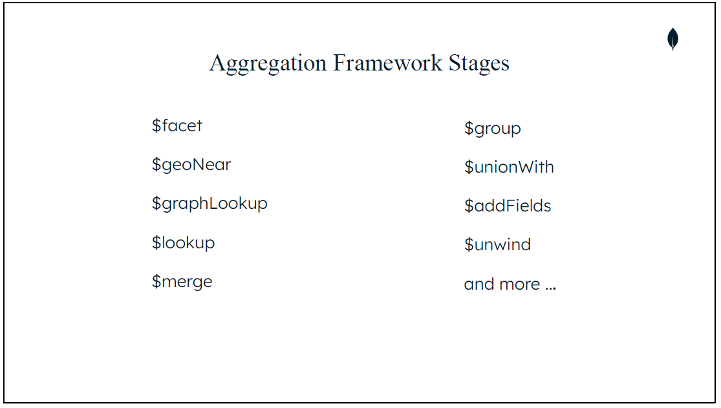
Notes:
Firstly, $facet allows multiple aggregation pipelines to be processed within this stage on the same set of input documents.
Next, $geoNear essentially provides $match, $sort, and $limit for geospatial data. This stage returns ordered stream of documents based on the proximity to a
geospatial point.
Thirdly, $graphLookup performs a recursive search on a collection.
The $lookup stage provides essentially a left outer join to another collection in the same database. This allows for those documents to “filter” into the “joined” collection for processing.
Fifthly, $merge is a related but separate stage to $out. The $merge stage adds the ability to output data to collections without overwriting them completely, it can update or replace documents based on options supplied to the stage. Additionally, this stage unlike $out can write to sharded collections.
$group is a really useful and important stage, it buckets each document into groups identified by a specific identifier expression. Each group has one document associated with it. It can apply accumulator expression(s) as part of this process. The
output document for each group will have the identifier expression and any specified accumulated fields.
The next stage we will look at is $unionWith, which will union two collections from two pipelines into a single result set.
The eight stage, $addFields allows for a field to be added to the document as it passes through this stage. The output document will contain the original fields and any ‘added’ fields from this stage. $set is an alias for $addFields
The last stage, we’ll highlight is the $unwind stage which allows an array field to be broken apart. Each element within the array will be made into a separate document.

Slide 7
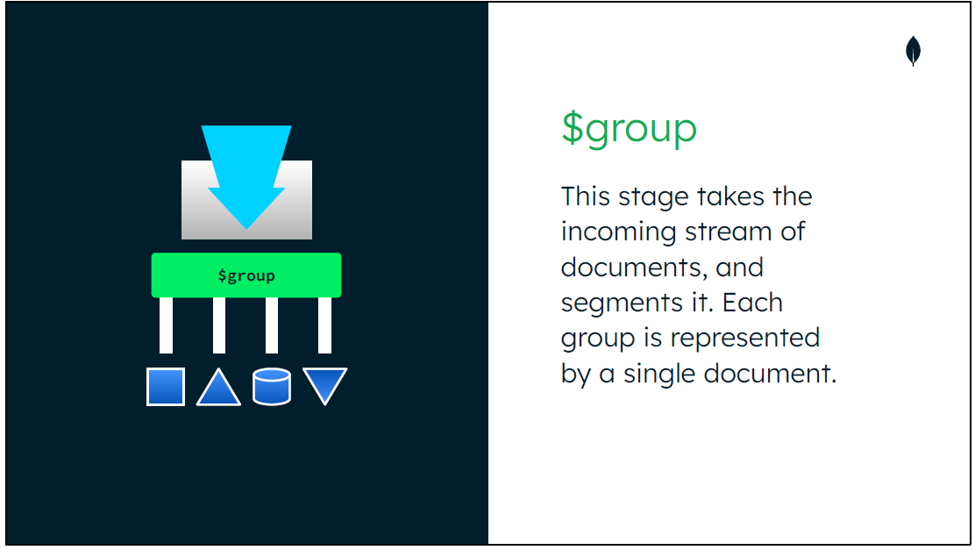

Slide 8
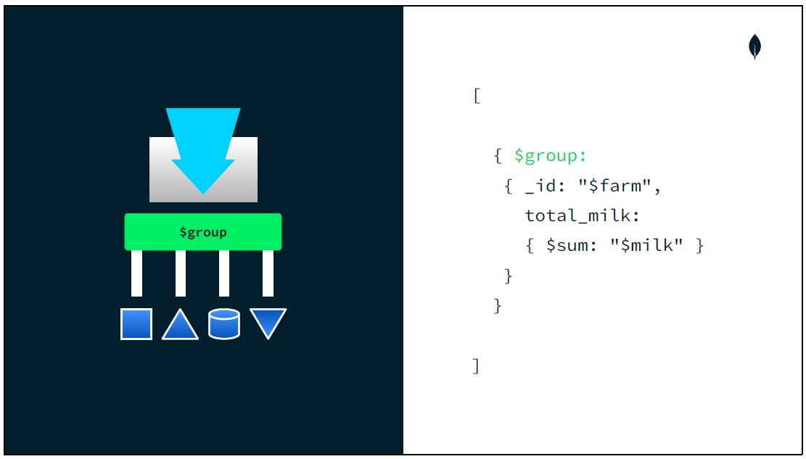

Slide 9
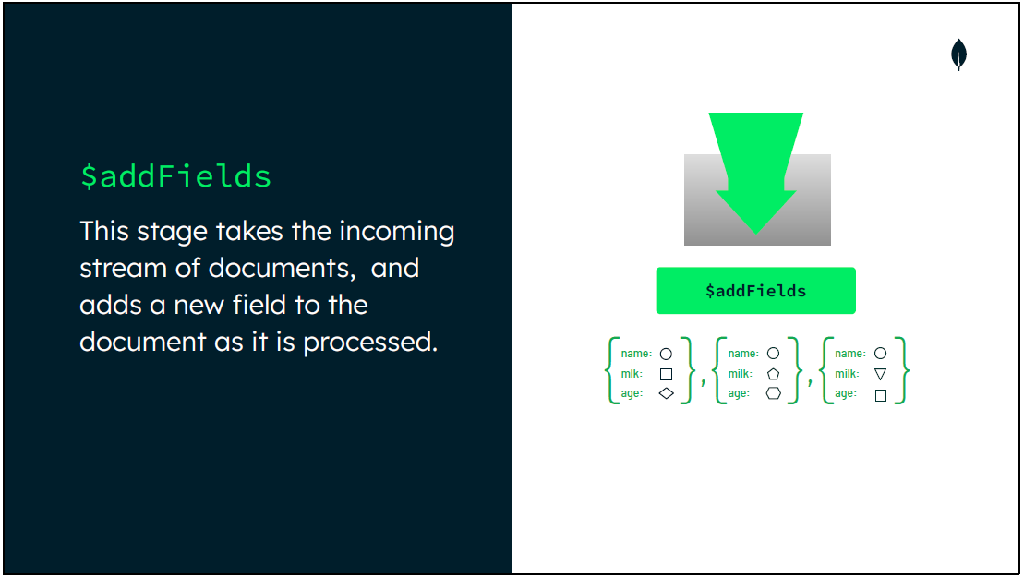

Slide 10
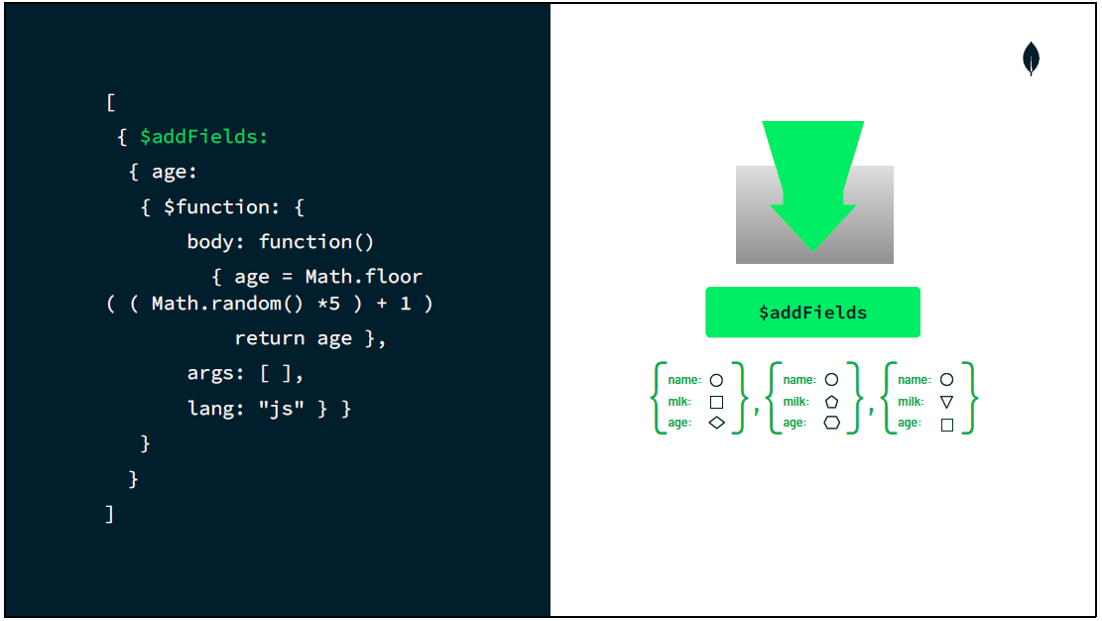

Slide 11
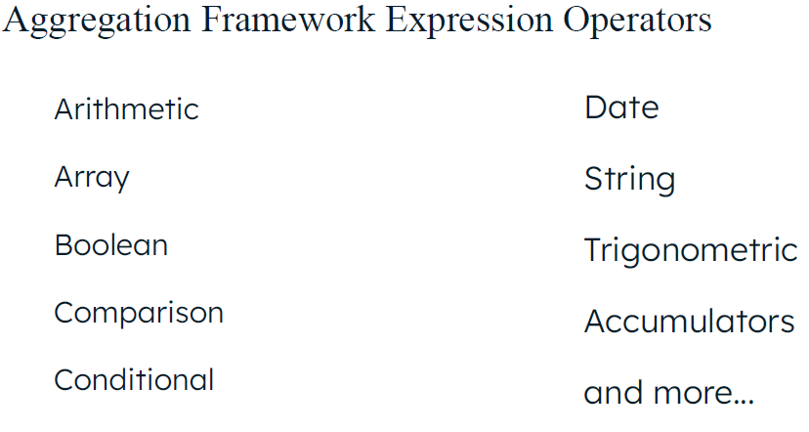
Aggregation Framework Expressions
Expressions consist of field paths, literals, system variables, expression objects, and expression operators. These can be nested.
Expression operators provide a wide range of functions. These can be used within a stage.
Field paths allow fields or fields within embedded documents to be accessed

Slide 12
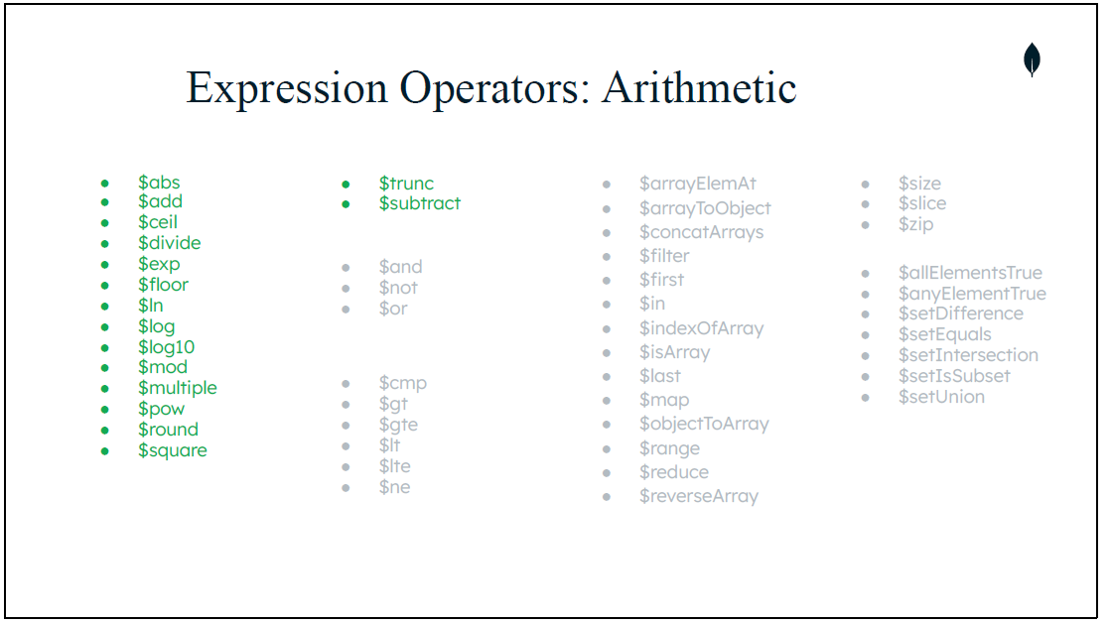

Slide 13
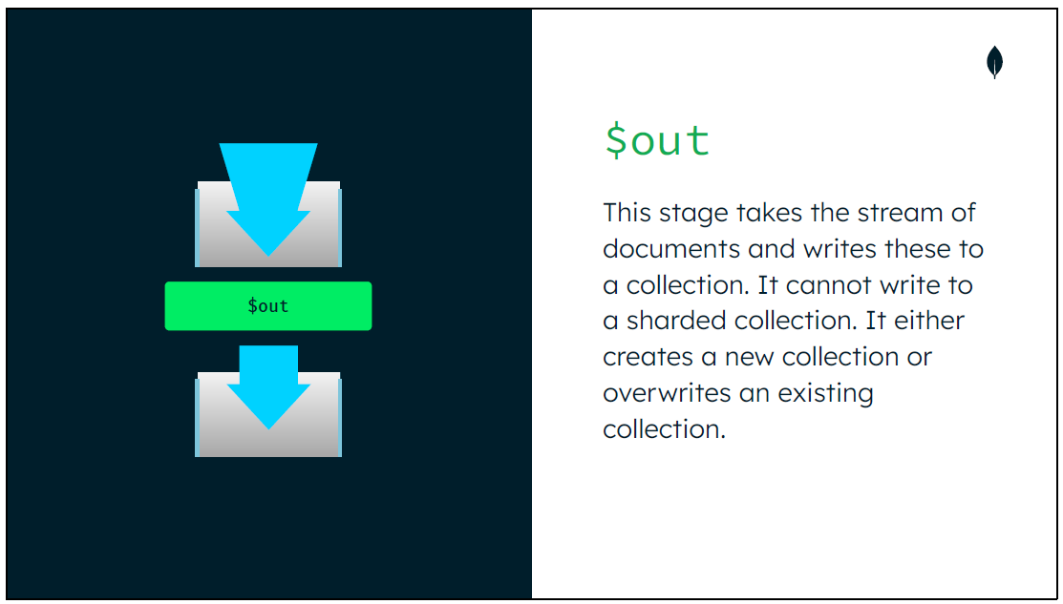
Outputting the Results

Slide 14
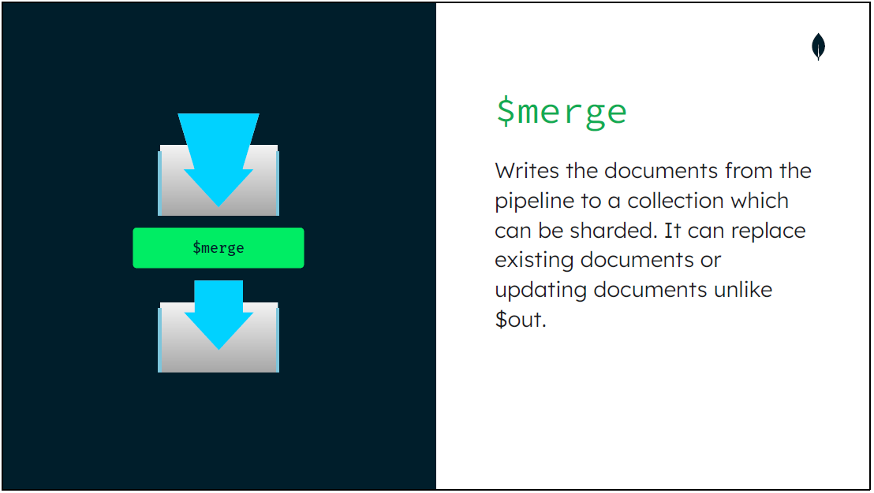

Slide 15
Lesson 16
Querying Data with the MongoDB Aggregation Framework

Slide 16
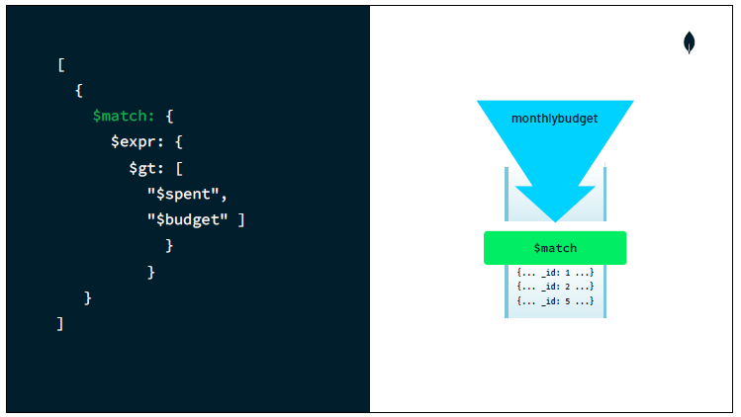
$match
Aggregation Framework $match
db.<collection>.aggregate({ $match: { <field>:<value>} })
Match uses filter document
More complex queries are possible with aggregation expressions
db.collection.aggregate({ $match: { $expr: { <expr>: { <field1>: <value1>}
} } }).
Use as early as possible in the pipeline, ideally as the first stage. This will improve the performance of the pipeline.
If first stage in the pipeline, can use indexes

Slide 17
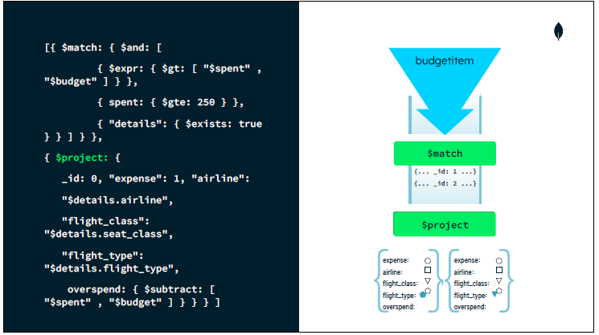
$project
db.<collection>.aggregate({ $project: { <specification(s)> }})
Project specification document
Aggregation expressions can reset an existing field or add a new field
db.collection.aggregate({ $project: { $field: <expr> } })
Include or exclude specific fields from the document
db.collection.aggregate({ $project: { $field: <1 or true> } })

Slide 18
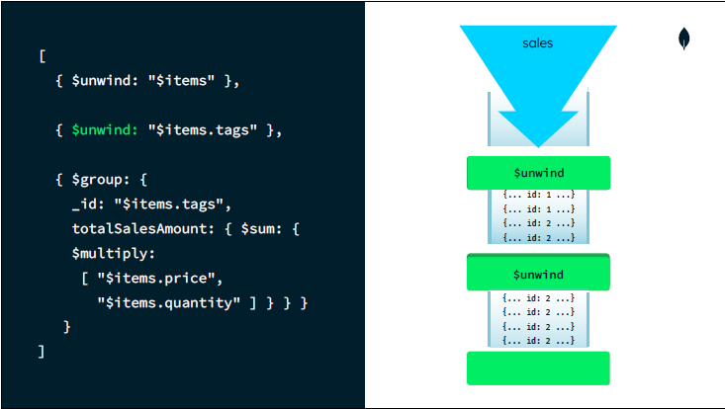
$unwind
Deconstruct an array field outputting a document for each element
Specify a field path to indicate the array to be deconstructed or specify a document operator
Unwind nested arrays
Control output document if there are empty or null arrays

Slide 19
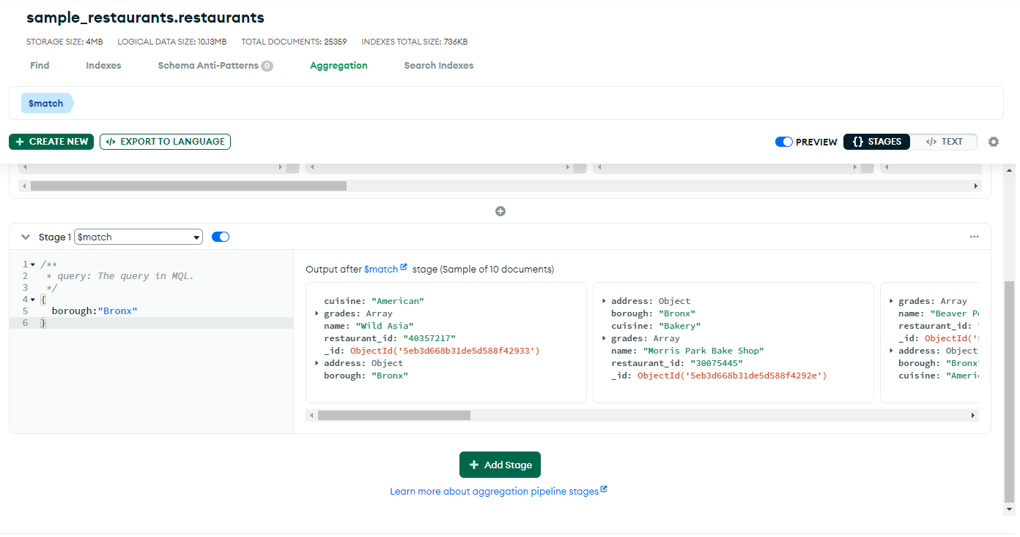
Using the Aggregation Tool
Stages can be defined within the Aggregation tab in Atlas
Each stage, once entered correctly will display query results
Add additional stages using the Add Stage button

Slide 20
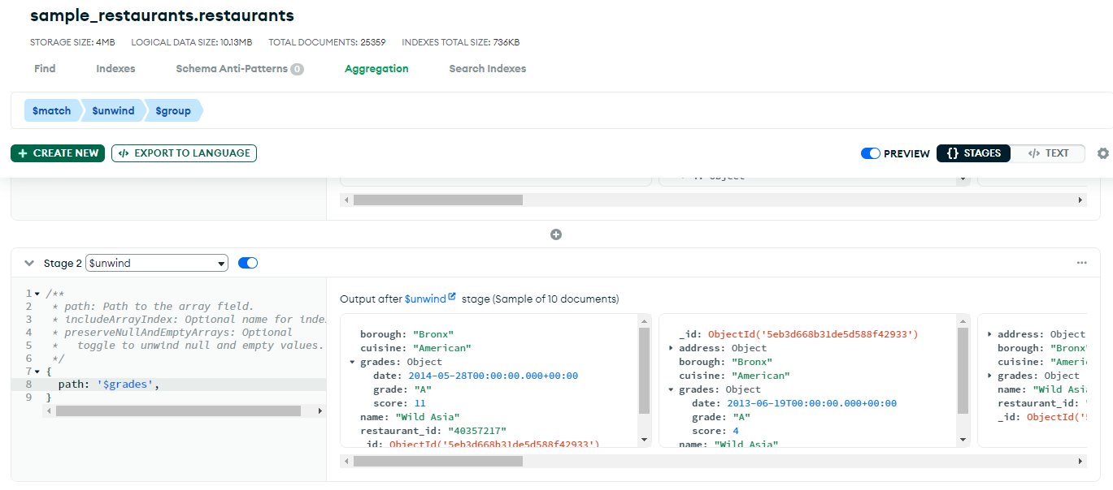

Slide 21
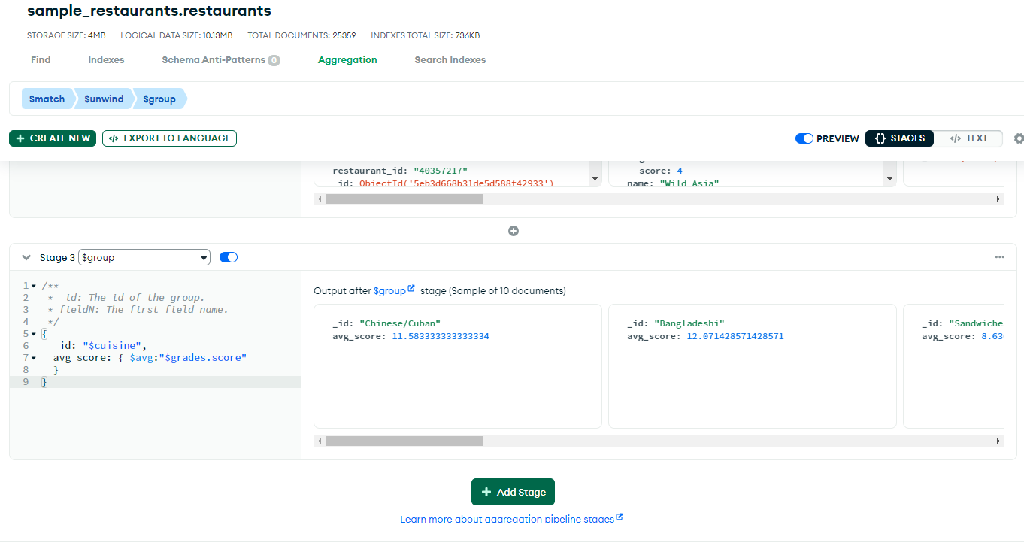

Slide 22
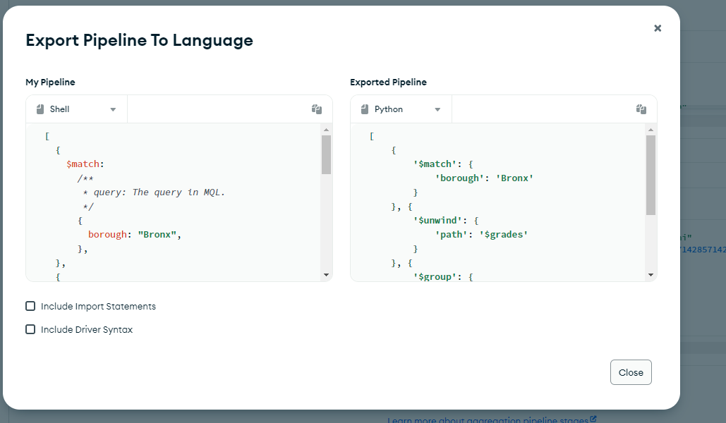

Slide 23
Lesson 20
Transactions in MongoDB

Slide 24
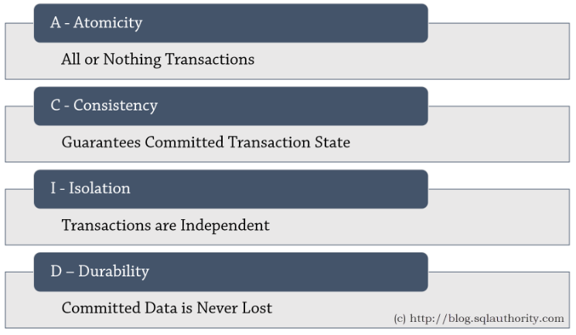
What is a Transaction?
A single unit of logic composed of multiple different database operations, which exhibits the following properties:
Atomic: either completes in its entirety or has no effect whatsoever (rolls back and is not left only partially complete)
Consistent: each transaction observes the latest current database state in the correct write ordering
Isolated: the state of an inflight transaction is not visible to other concurrent inflight transactions (and vice versa)
Durable: changes are persisted and cannot be lost if there is a system failure

Slide 25
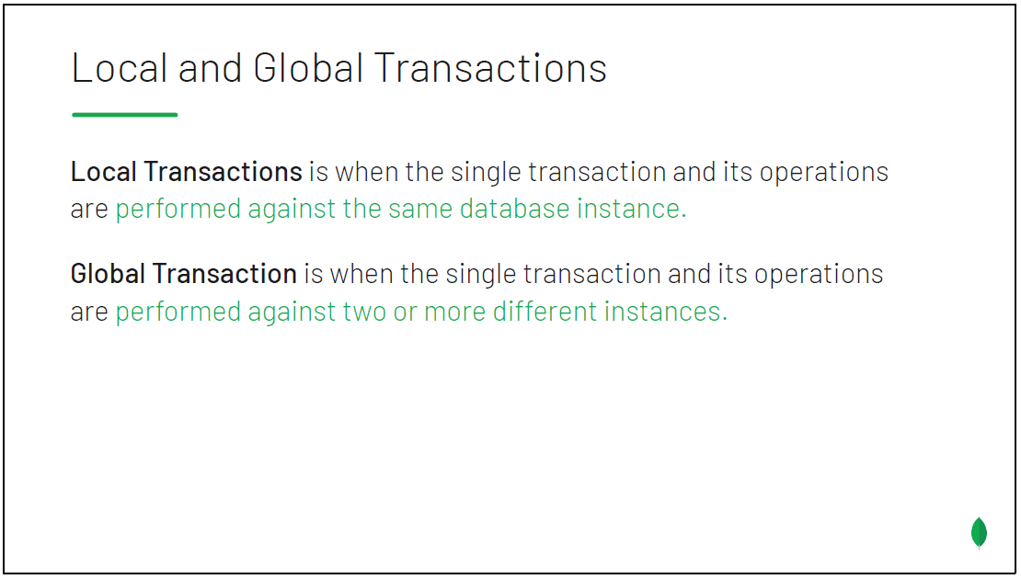

Slide 26
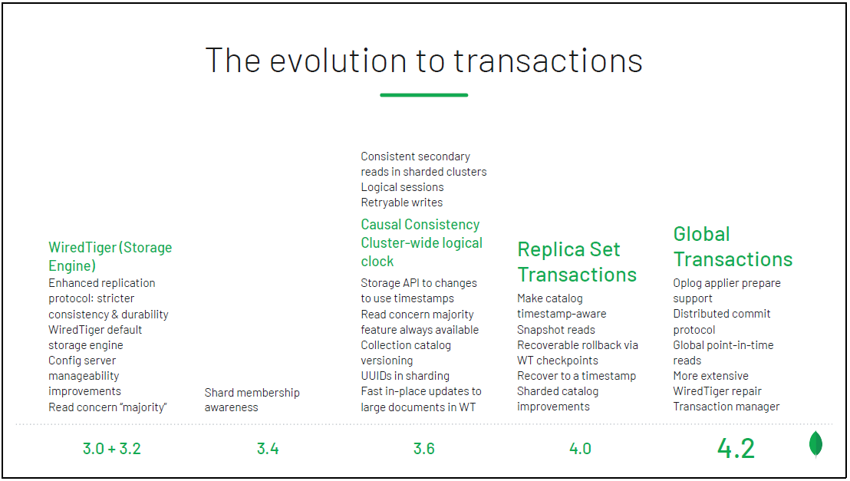
Notes:
3.6 also added a logical global clock that enabled synchronization across clusters and shards.

Slide 27
